Slide 1
Workcase 3
Виконали: Чех І. В. та Дзизиль Д.Є.

Slide 2
Клонування вашої віртуальної робочої ОС

Slide 3
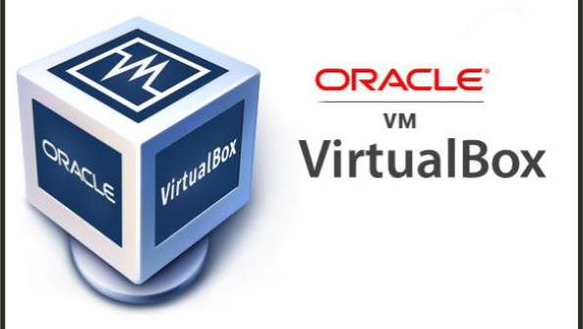
01
‘//’
Виконав студент: Дзизиль Д.Є.
//

Slide 4
—Someone Famous
Виконав студент: Дзизиль Д.Є.
01
//

Slide 5
02
‘//’
Виконав студент: Дзизиль Д.Є.
//

Slide 6
—Someone Famous
Виконав студент: Дзизиль Д.Є.
02
//

Slide 7
03
‘//’
Виконав студент: Дзизиль Д.Є.
//

Slide 8
—Someone Famous
Виконав студент: Дзизиль Д.Є.
03
//

Slide 9
04
‘//’
Виконав студент: Дзизиль Д.Є.
//

Slide 10
—Someone Famous
Виконав студент: Дзизиль Д.Є.
04
//

Slide 11
05
‘//’
Виконав студент: Дзизиль Д.Є.
//

Slide 12
—Someone Famous
Виконав студент: Дзизиль Д.Є.
05
//

Slide 13
06
‘//’
Виконав студент: Дзизиль Д.Є.
You can enter a subtitle here if you need it

Slide 14
—Someone Famous
Виконав студент: Дзизиль Д.Є.
06
//

Slide 15
Опишіть які типи організації мережевих з’єднань підтримуються в середовищі віртуальних машин, в чому особливість кожного з них:

Slide 16

Network Address Translation (NAT):
Feature: In NAT mode, VirtualBox creates an internal network for virtual machines and uses NAT to establish connections with the external network. Each virtual machine is assigned an IP address in this internal network, and access to the internet and other resources of the external network is facilitated through NAT.
Purpose: It is used when you want your virtual machines to have access to the internet or other external network resources but do not require public IP addresses.
Виконав студент: Чех І. В.

Slide 17
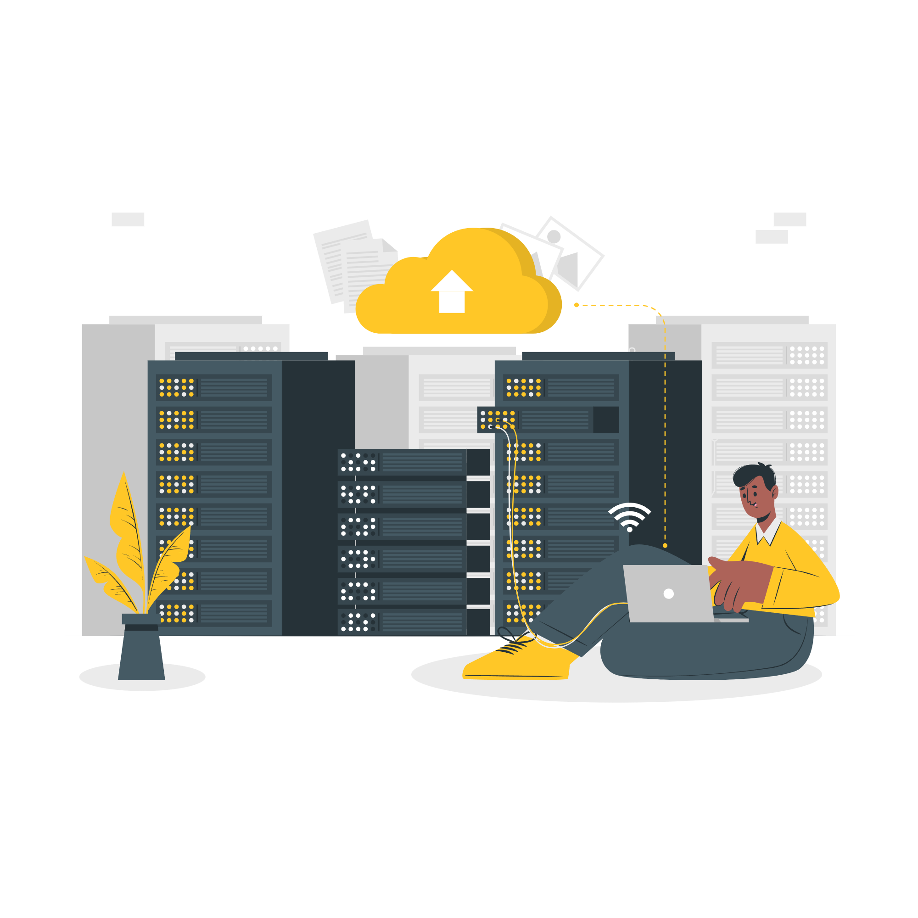
Network bridge:
Feature: In Bridged mode, the virtual machine is connected directly to the physical network, like other computers on your local network. It receives its own IP address from the local network and can communicate with other devices on this network.
Purpose: Used when you need a virtual machine to be fully visible and accessible on the local network like any other physical computer.
Виконав студент: Чех І. В.

Slide 18

Virtual host adapter (Host-only):
Feature: In Host-only mode, virtual machines can communicate only with each other and with the host system, but do not have access to an external network or the Internet. They get IP addresses from the internal virtual network.
Purpose: Used when you need to create an isolated network for internal testing or development and you do not want the virtual machines to have access to the external network.
Виконав студент: Чех І. В.

Slide 19
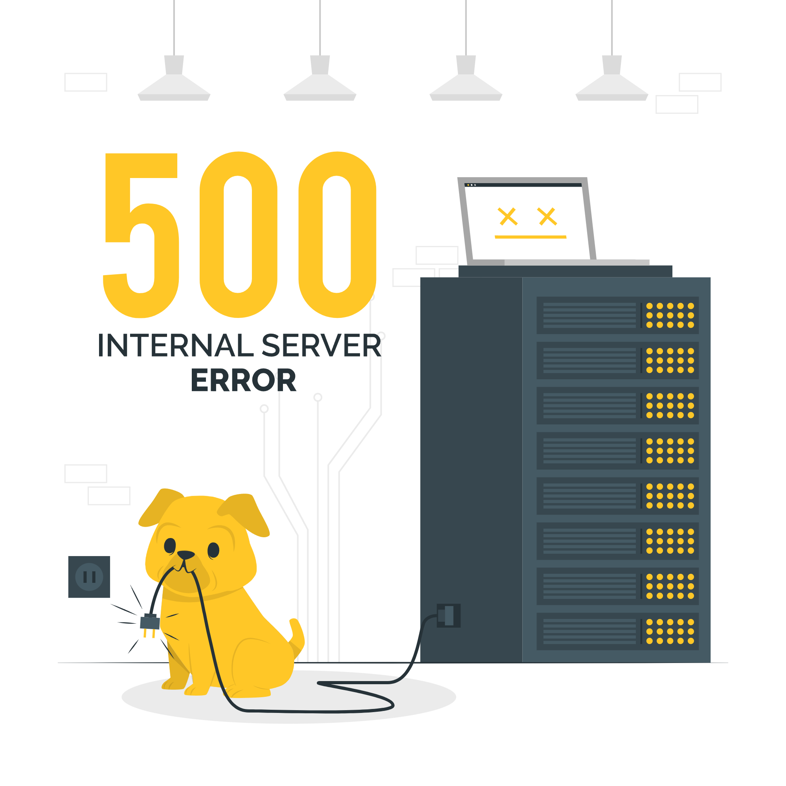
Internal network:
Feature: In Internal Network mode, virtual machines connect to an internal network and can only communicate with each other and with the host system, if such a network is configured. They do not have access to an external network or the Internet.
Purpose: Used when you need to create a closed internal network for virtual machines that must communicate with each other but must not be accessible from the outside.
Виконав студент: Чех І. В.

Slide 20
